Slide 1
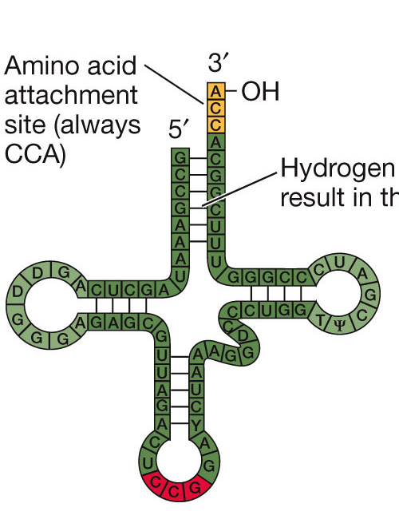
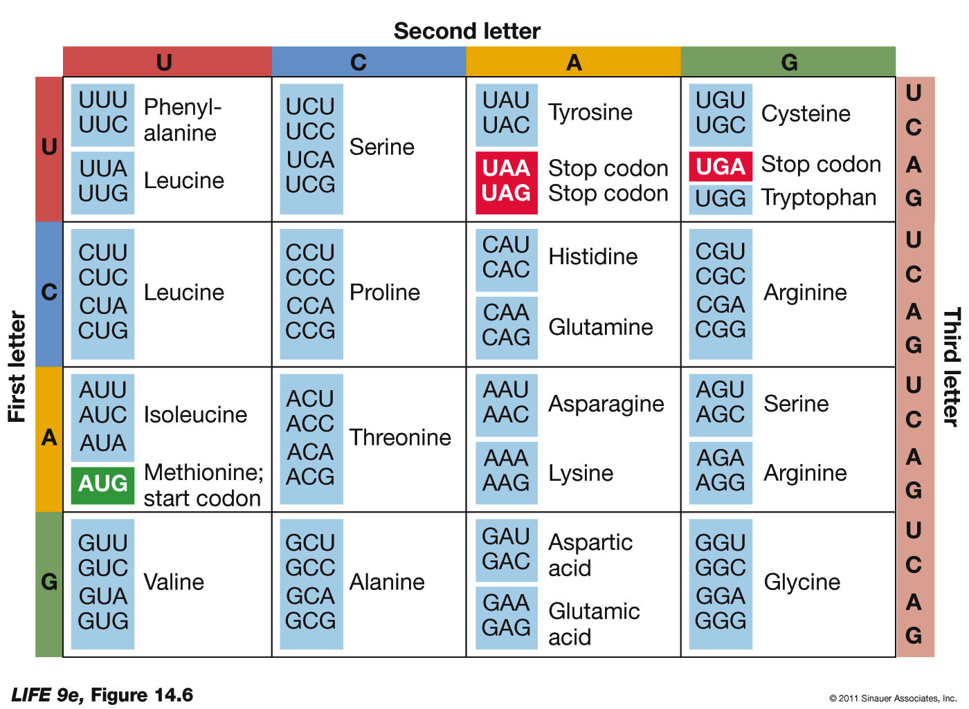
Intro to Biotech
Lect.7
DNA – mRNA – protein
DNA
5’ Tata x_{n} Aaacatcgcgaatcc ATG
3’ Atat x_{n} tttgtagcgcttagg TAC
5’
mRNA
gaaucc AUG GAG CAG GUG CUC AUA UAG
UAC
Met

Slide 2
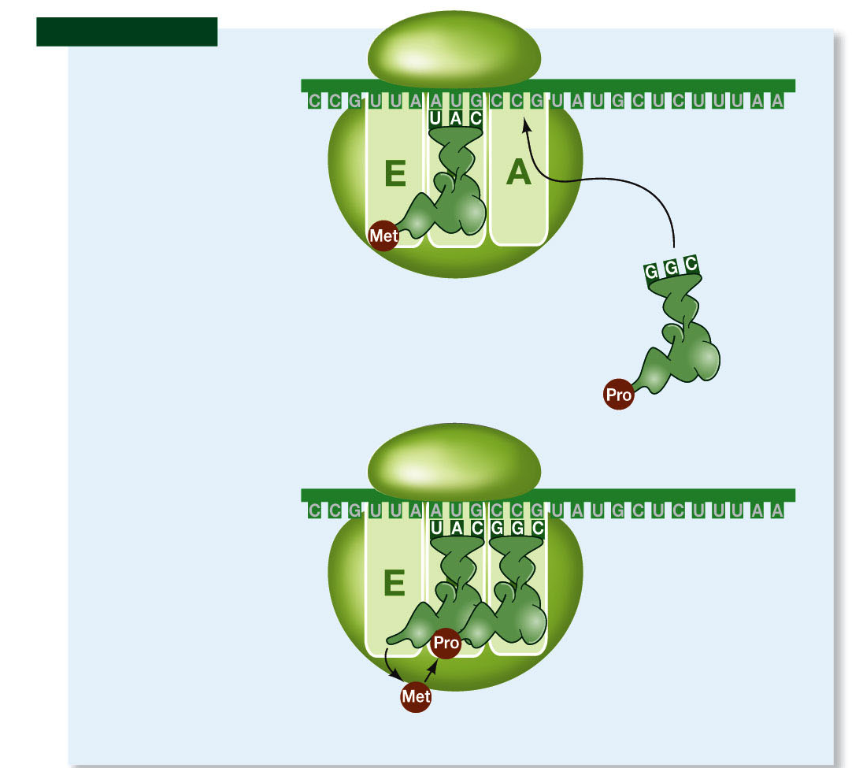
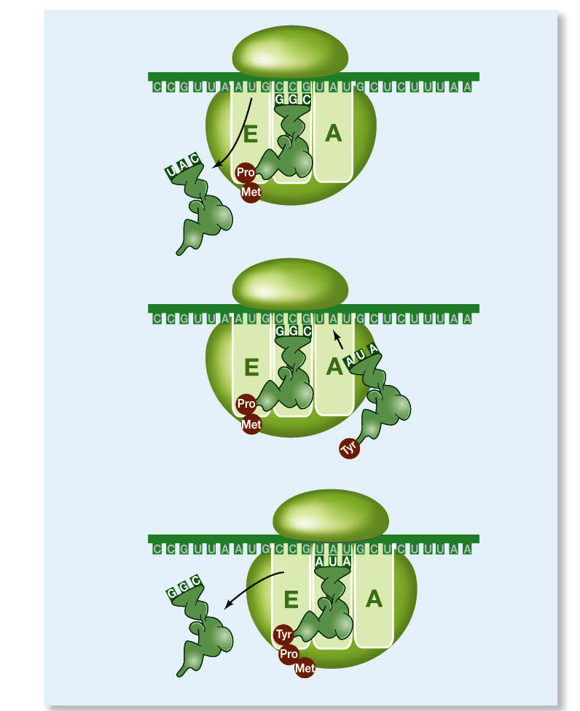
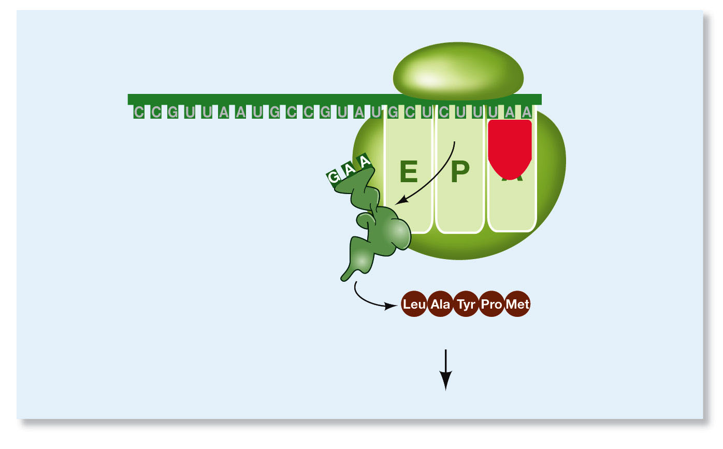
Intro to Biotech
Lect.7
mRNA – where do we go from here?
Translation
- components: tRNAs, aa’s, ribosomes
- 3 steps
a.
b.
c.
3rRNA
+
45 proteins
Protein – where do
we go from here

Slide 3
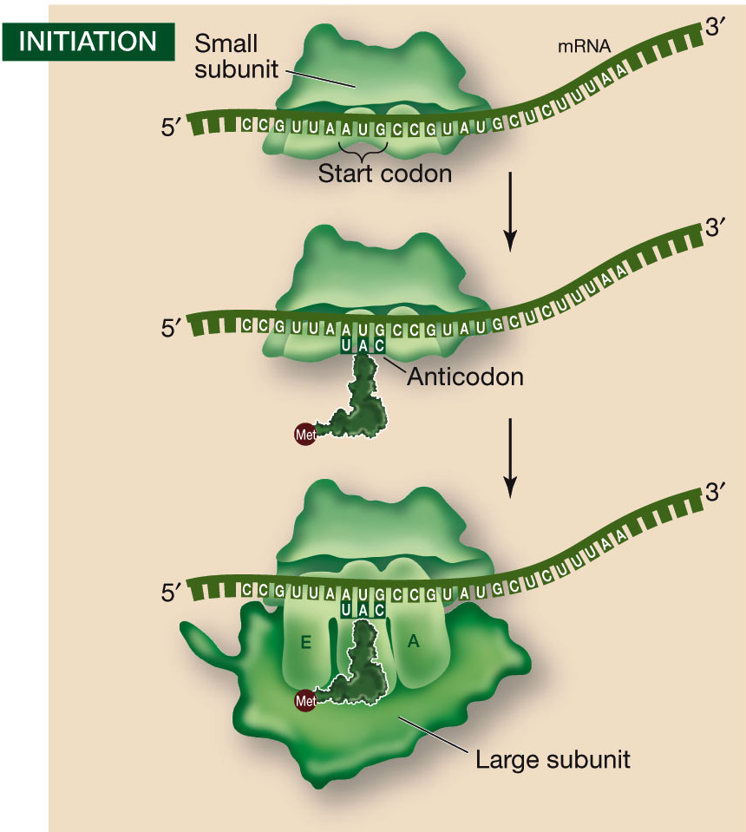
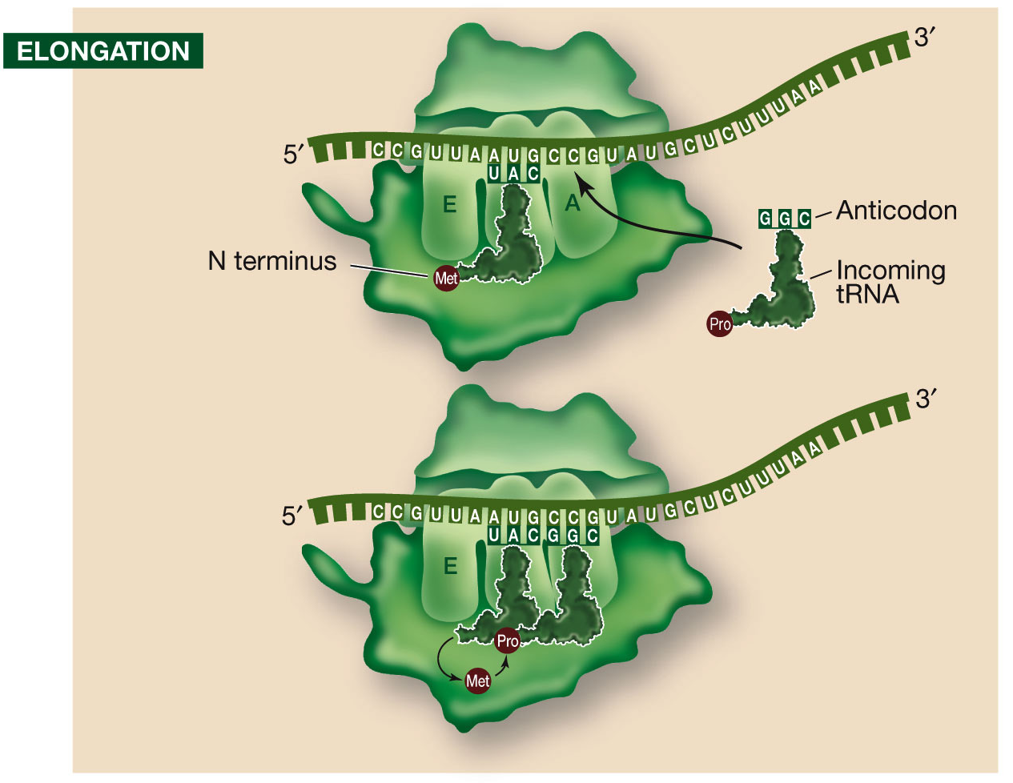
Intro to Biotech
Lect.7
DNA – mRNA – protein
5’
gaaucc AUG GAG CAG GUG CUC AUA UAG
UAC
Met
Glu
Gln
a. initiation:
Elongation:

Slide 4
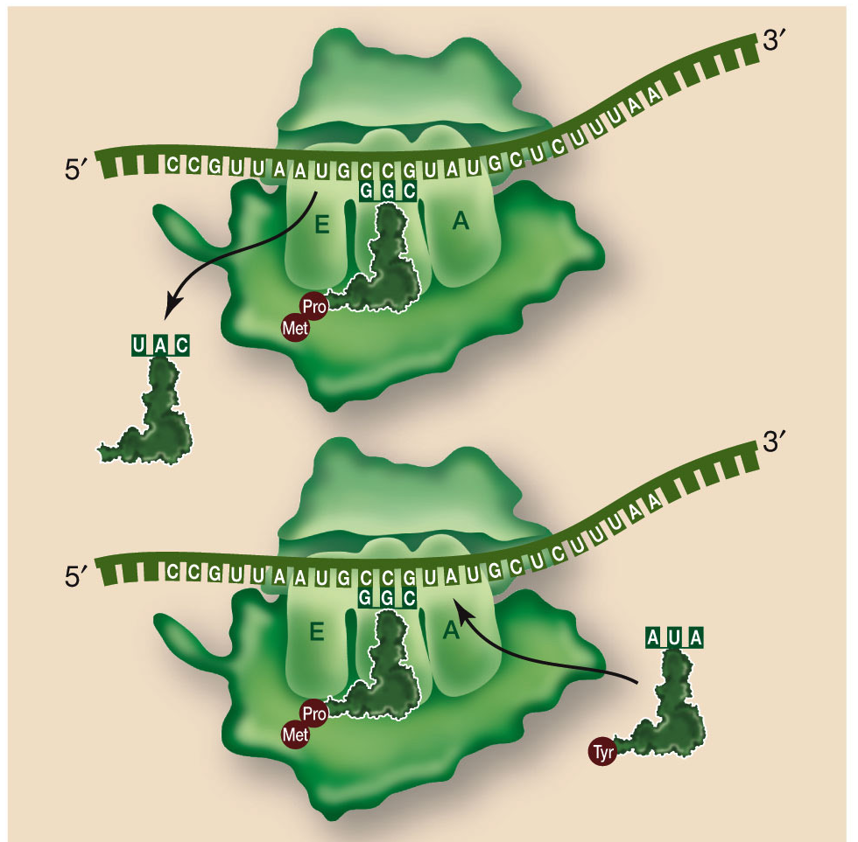
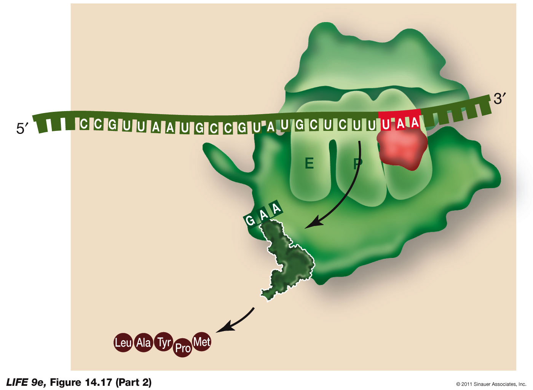
Intro to Biotech
Lect.7
DNA – mRNA – protein
5’
gaaucc AUG GAG CAG GUG CUC AUA UAG
UAC
Met
Glu
Gln
Elongation:
Termination:

Slide 5
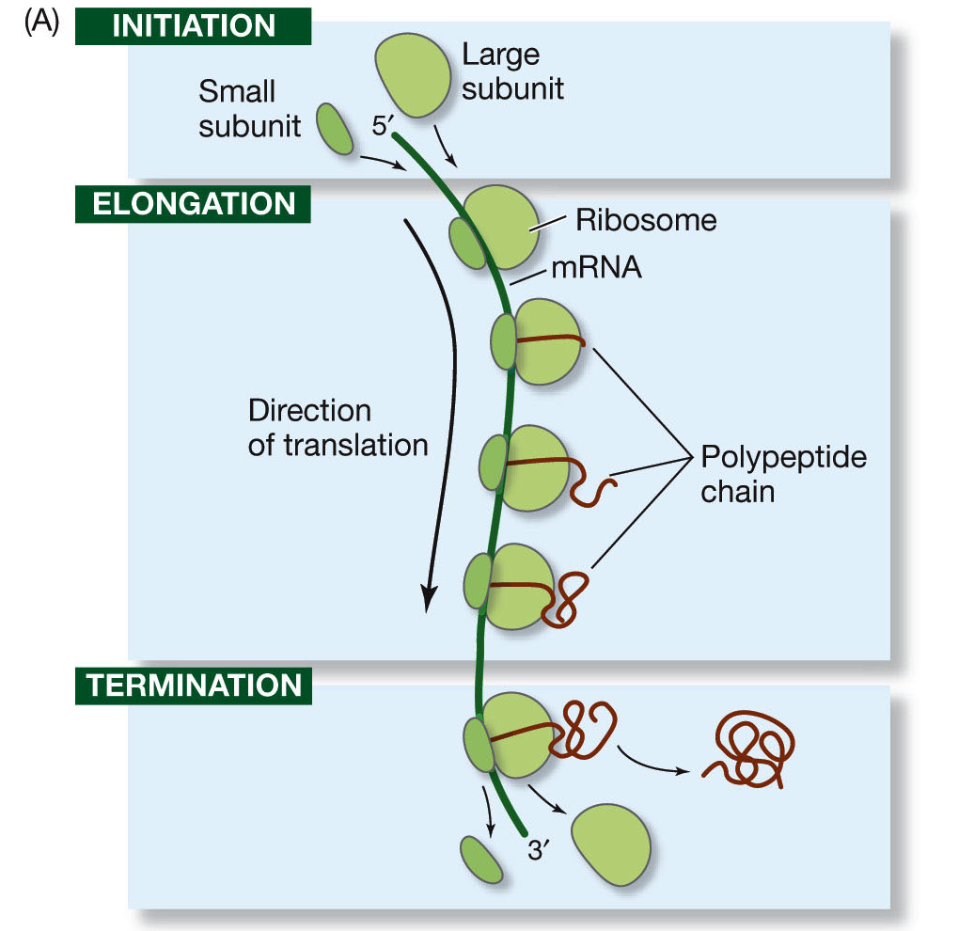
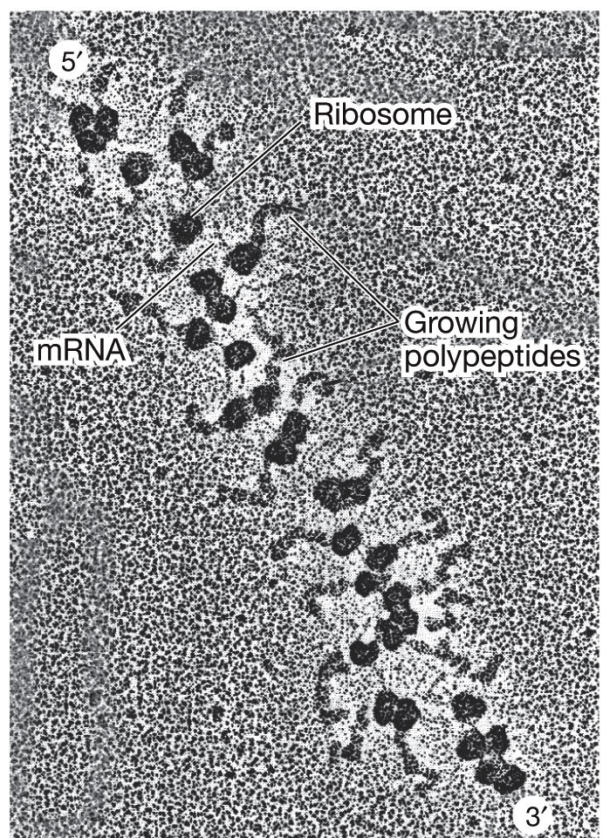
Intro to Biotech
Lect.7
DNA – mRNA – protein
5’
gaaucc AUG GAG CAG GUG CUC AUA UAG
UAC
Met
Glu
Gln

Slide 6
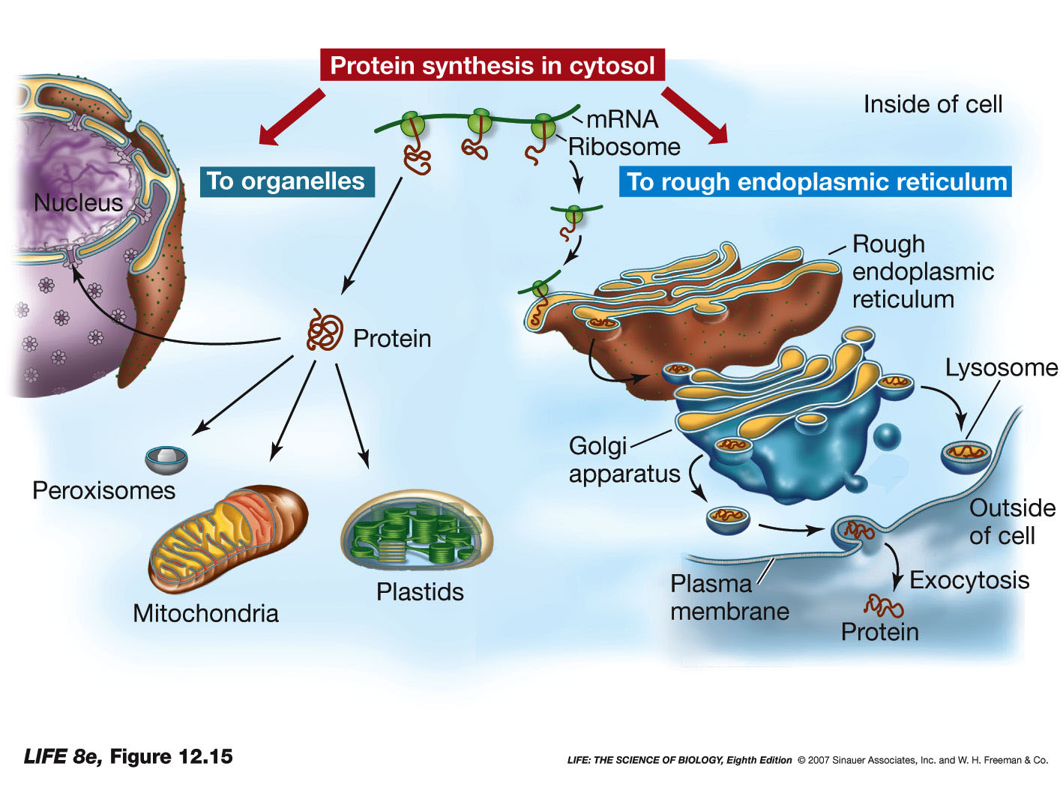
Intro to Biotech
Lect.7
DNA – mRNA – protein
5’
gaaucc AUG GAG CAG GUG CUC AUA UAG
UAC
Met
Glu
Gln
Subcellular localization
-
•
•
(types of proteins?)

Slide 7
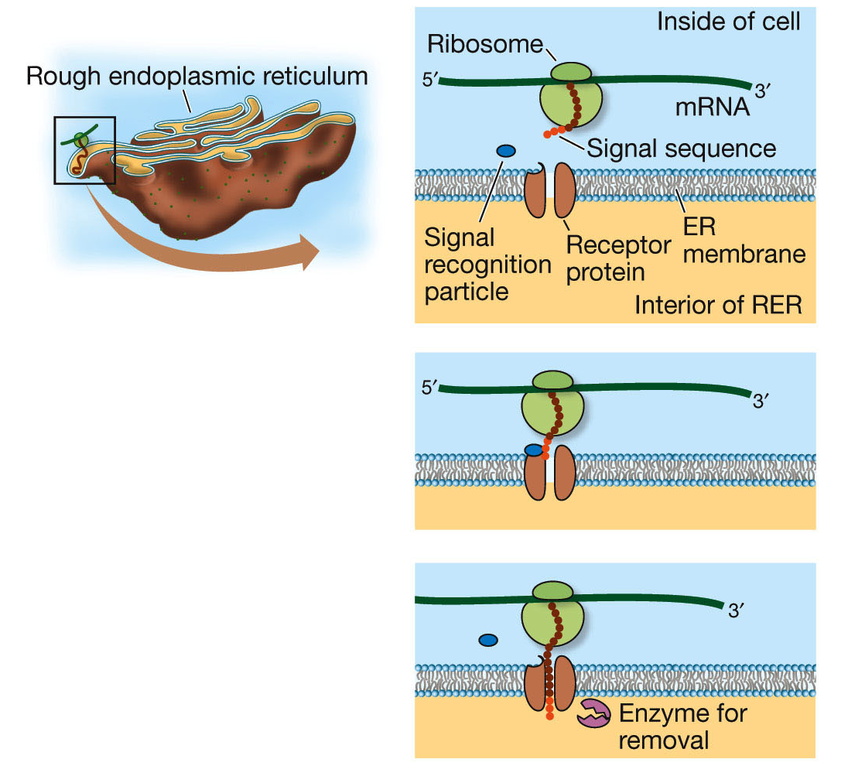
Intro to Biotech
Lect.7
DNA – mRNA – protein
5’
gaaucc AUG GAG CAG GUG CUC AUA UAG
UAC
Met
Glu
Gln
• signal sequence –

Slide 8
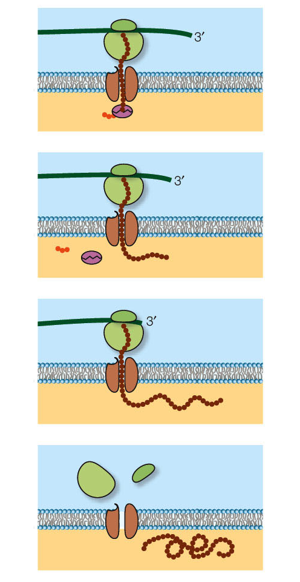
Intro to Biotech
Lect.7
DNA – mRNA – protein
5’
gaaucc AUG GAG CAG GUG CUC AUA UAG
UAC
Met
Glu
Gln
• signal sequence –
Is Met present in
secreted proteins?

Slide 9
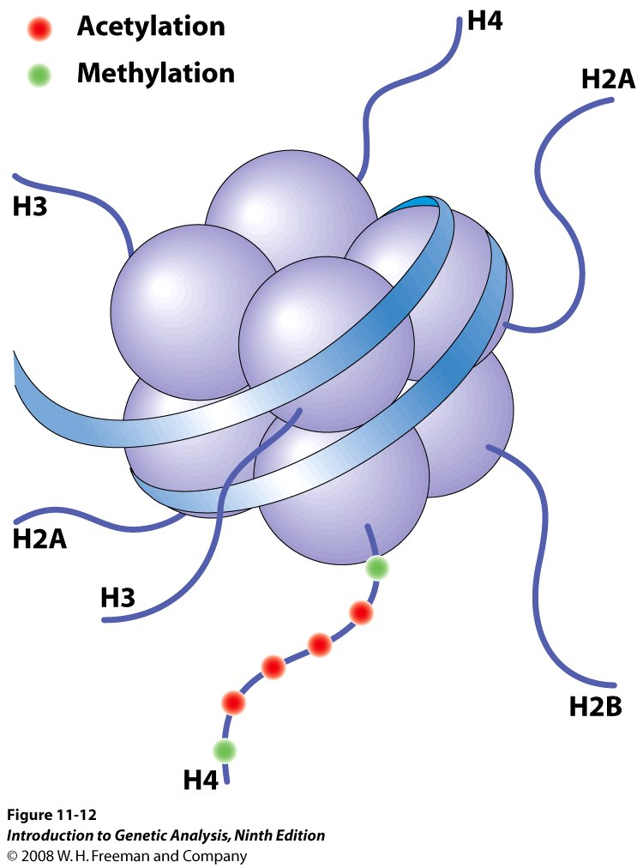
Intro to Biotech
Lect.7
DNA – mRNA – protein
5’
gaaucc AUG GAG CAG GUG CUC AUA UAG
UAC
Met
Glu
Gln
DNA – mRNA – protein - processing
Processing:
•
•
•
•
•
•
Histone
code
25-40aa.

